Slide 2
Prediction SVM
Trainings data:
52 prostate (PRAD) cases
112 breast (BRCA) cases
58 thyroid (THCA) cases
49 lung (LUSC) cases
(126 kidney (KIRC, KIRP, KICH))
Features
Unique Prostate cancer Malacard genes
Direct high scoring neighbors in GIANT prostate_gland network
117 Genes

Slide 3
Prediction SVM – PatientSet1
 | Observed Prostate | Observed other
Predicted Prostate | 10 | 4 (all KICH)
Predicted other | 0 | 86
Lung, breast, thyroid as negative set

Slide 4
Prediction SVM – PatientSet1
 | Observed Prostate | Observed other
Predicted Prostate | 10 | 4 (all KICH)
Predicted other | 0 | 86
 | Observed Prostate | Observed other
Predicted Prostate | 10 | 0
Predicted other | 0 | 90
Lung, breast, thyroid as negative set
Lung, breast, thyroid, kidney as negative set

Slide 5
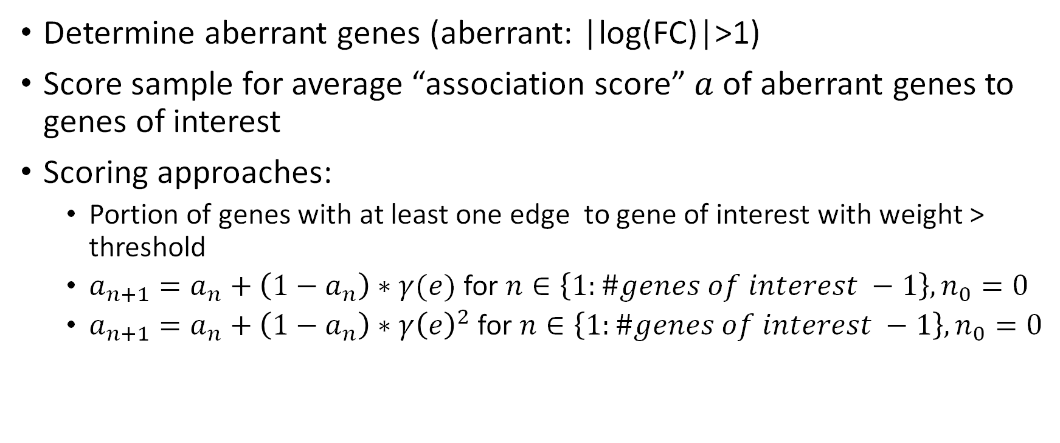
Prediction Aberrant neighbors
Determine aberrant genes (aberrant: |log(FC)|>1)
Score sample for average “association score” $a$ of aberrant genes to genes of interest
Scoring approaches:
Portion of genes with at least one edge to gene of interest with weight > threshold
$a_{n+1}=a_{n}+\left(1−a_{n}\right)∗γ(e)$ for $n∈\left\{1:\#genes of interest −1\right\}, n_{0}=0$
$a_{n+1}=a_{n}+\left(1−a_{n}\right)∗γ{\left(e\right)}^{2}$ for $n∈\left\{1:\#genes of interest −1\right\}, n_{0}=0$

